Slide 1

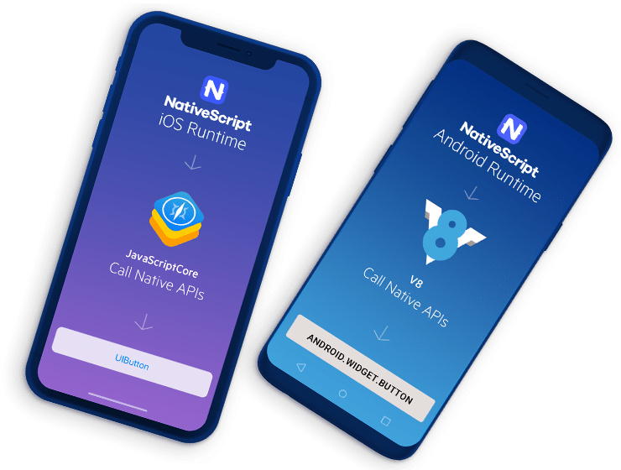


Slide 2

Welcome
19:00 Introduction to NativeScript
19:45 Hands - on
21:00 End

Slide 3
What is NativeScript?
Open source framework for building truly native mobile apps with
Angular
Vue.js
TypeScript, JavaScript, CSS

Slide 4
It is not like Cordova / Ionic ...

Slide 5
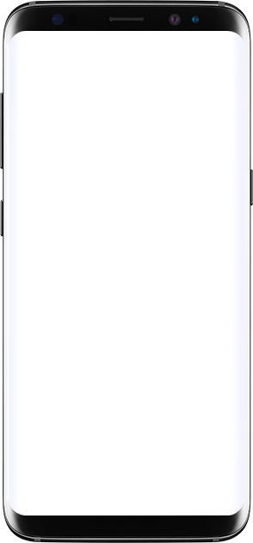
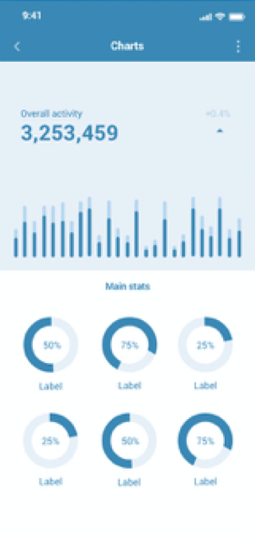
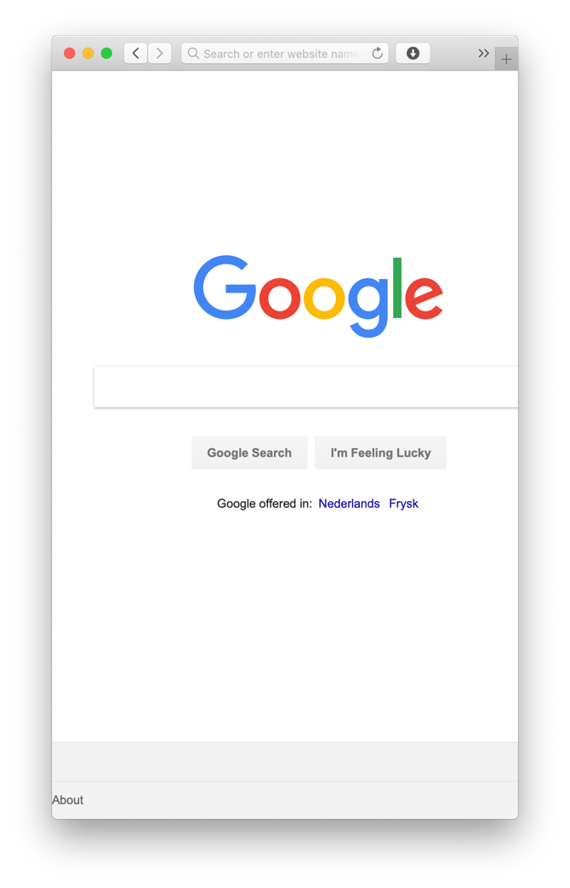

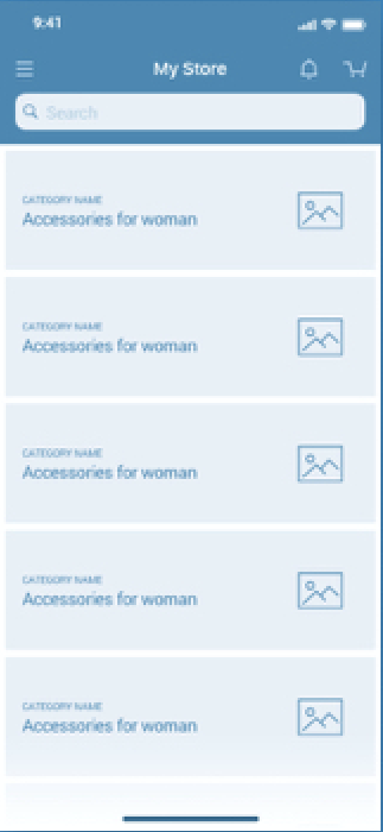
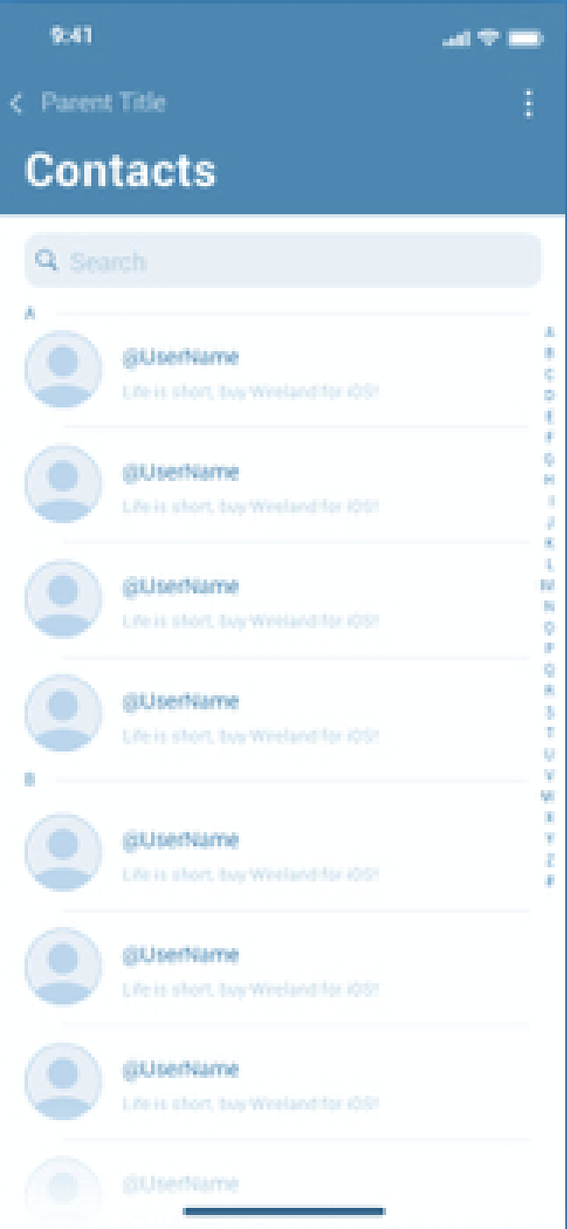
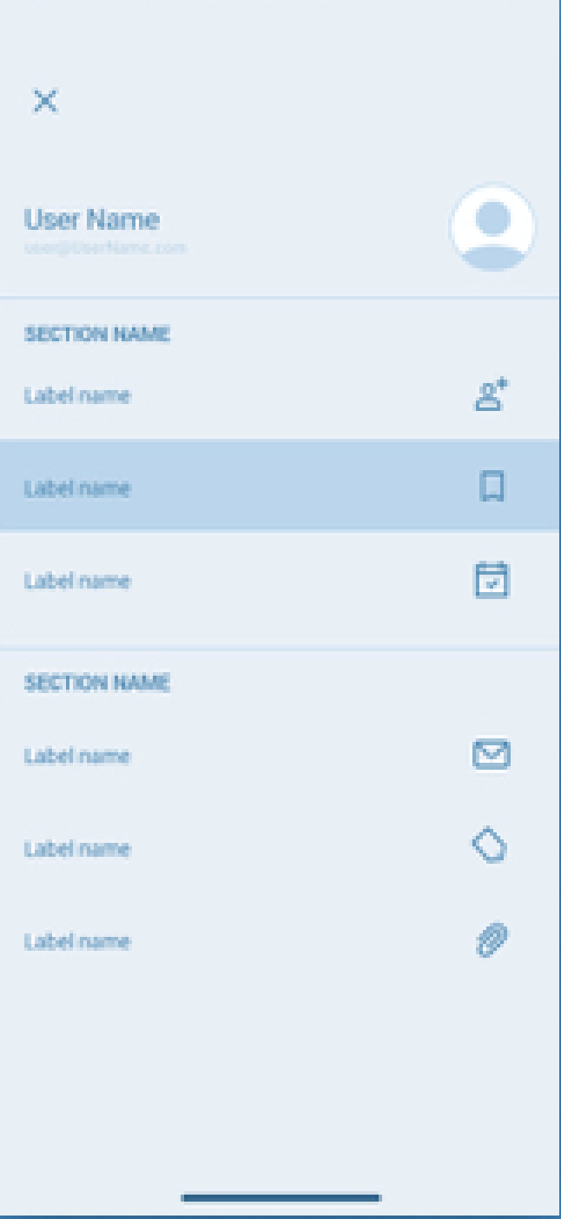
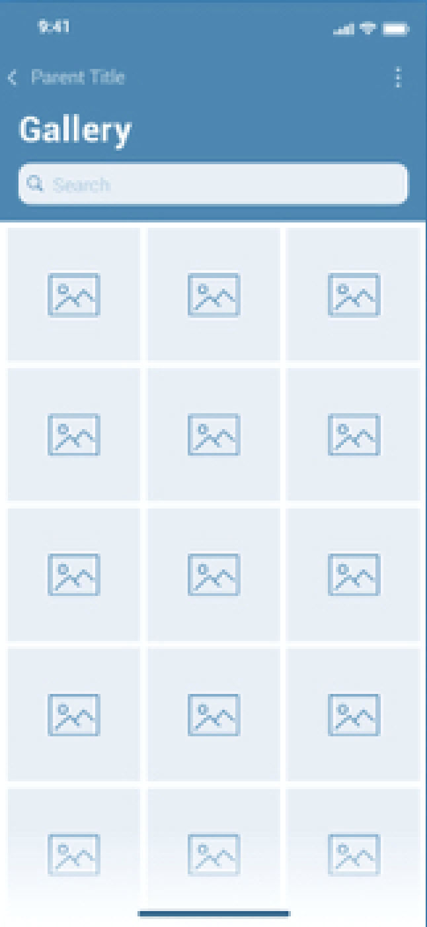

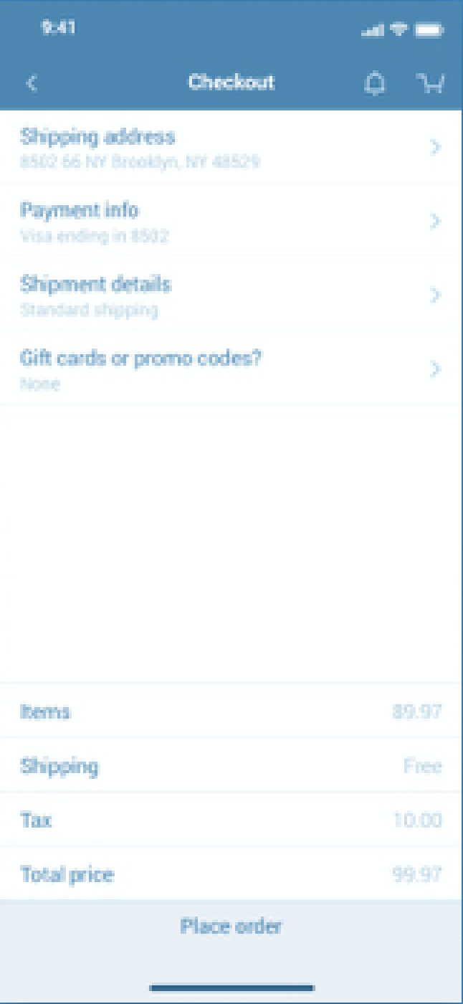
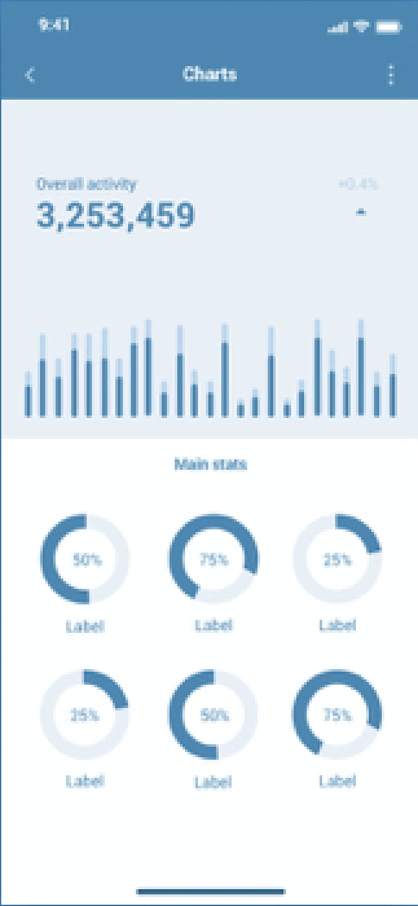
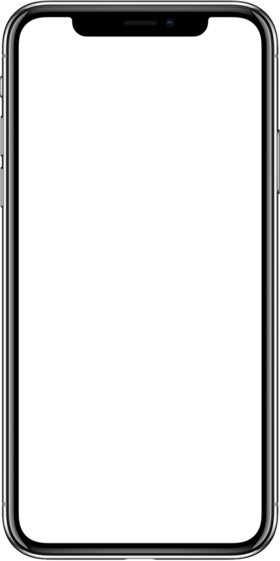
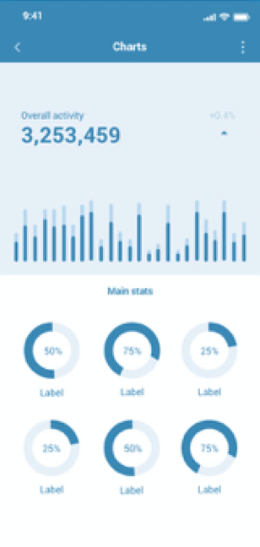

android.webkit. WebView
UIWebView

Slide 6
How does NativeScript work?

Slide 7
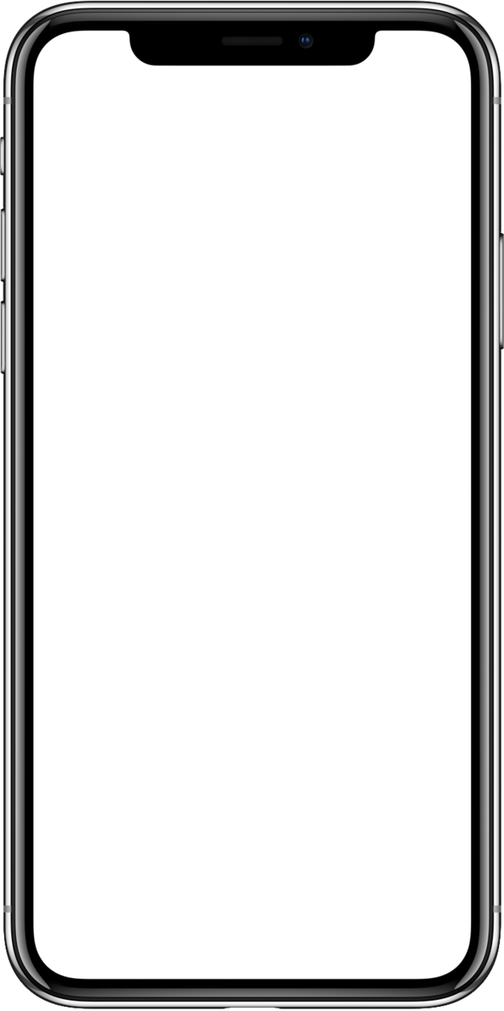



NativeScript
Build UI
NativeScript
iOS Runtime
<Button
(tap)="onTap($event)"
class="btn">
</Button>
Android Runtime
↓
↓
Write app logic
Call Native APIs
Call Native APIs
Style with CSS
↓
↓
.btn { background-color: #eeeeee; color: black; border-radius: 4; }
UIButton
android.widget.Button

Slide 8
UI Widgets

Slide 9
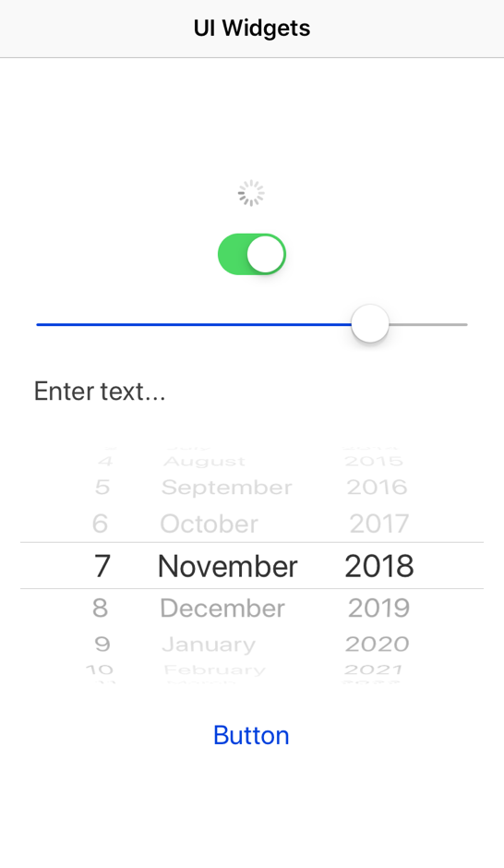
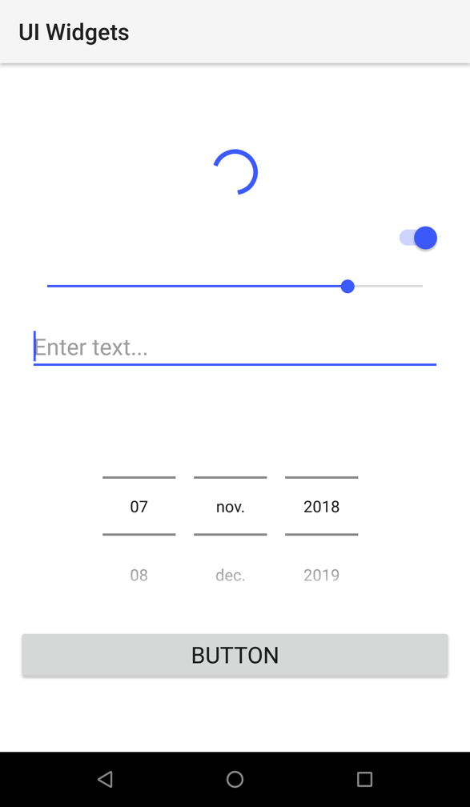


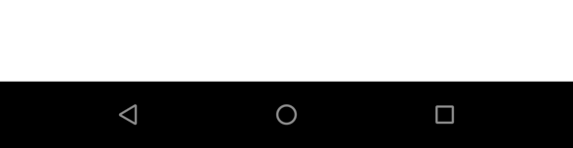
UI Widgets
<ActionBar title="UI Widgets"></ActionBar>
<ActivityIndicator busy="true"></ActivityIndicator>
<Switch checked="true"></Switch>
<Slider value="80"></Slider>
<TextField hint="Enter text..."></TextField>
<DatePicker minDate="2018-11-07"></DatePicker>
<Button text="Button"></Button>

Slide 10
UI Widgets
Dialogs
FormattedString
Gestures
HtmlView
Image
Label
ListPicker
ListView
Placeholder
Progress
ScrollView
SearchBar
SegementedBar
TabView
TextView
TimePicker
WebView
https://docs.nativescript.org/angular/ui/components

Slide 11
Layout Containers

Slide 12
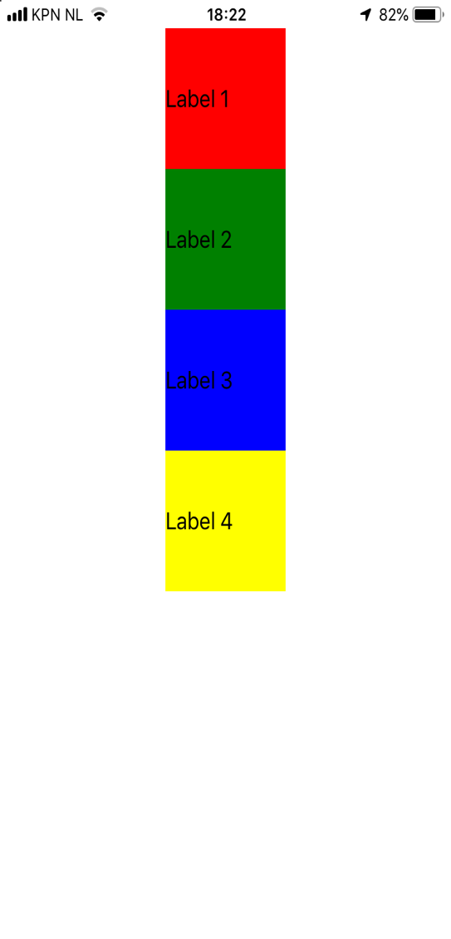
StackLayout
<StackLayout>
<Label text="Label 1" backgroundColor="red" width="100" height="100"></Label>
<Label text="Label 2" backgroundColor="green" width="100" height="100"></Label>
<Label text="Label 3" backgroundColor="blue" width="100" height="100"></Label>
<Label text="Label 4" backgroundColor="yellow" width="100" height="100"></Label>
</StackLayout>

Slide 13
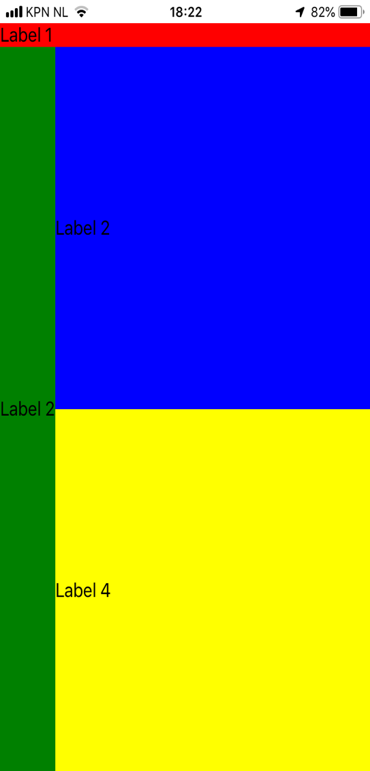
GridLayout
<GridLayout columns="auto, *" rows="auto, *, *">
<Label text="Label 1" row="0" col="0" colSpan="2" backgroundColor="red"></Label>
<Label text="Label 2" row="1" col="0" rowSpan="2" backgroundColor="green"></Label>
<Label text="Label 2" row="1" col="1” backgroundColor="blue"></Label>
<Label text="Label 4" row="2" col="1” backgroundColor="yellow"></Label>
</GridLayout>

Slide 14
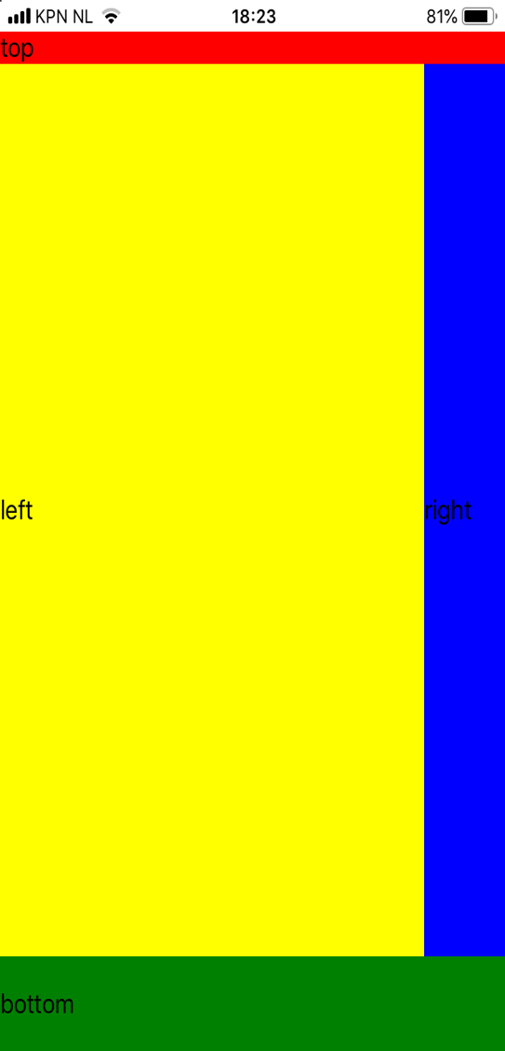
DockLayout
<DockLayout>
<Label text="top" dock="top” backgroundColor="red"></Label>
<Label text="bottom" dock="bottom" height="60" backgroundColor="green"></Label>
<Label text="right" dock="right" width="60" backgroundColor="blue"></Label>
<Label text="left" dock="left" backgroundColor="yellow"></Label>
</DockLayout>

Slide 15
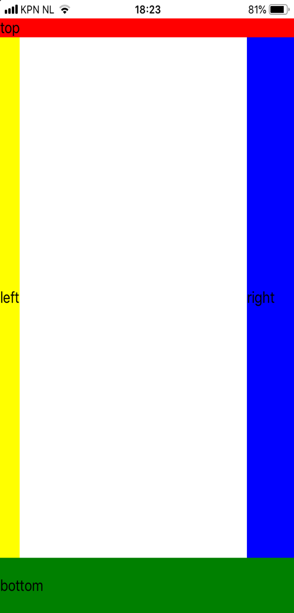
DockLayout
<DockLayout stretchLastChild="false">
<Label text="top" dock="top” backgroundColor="red"></Label>
<Label text="bottom" dock="bottom" height="60" backgroundColor="green"></Label>
<Label text="right" dock="right" width="60" backgroundColor="blue"></Label>
<Label text="left" dock="left" backgroundColor="yellow"></Label>
</DockLayout>

Slide 16
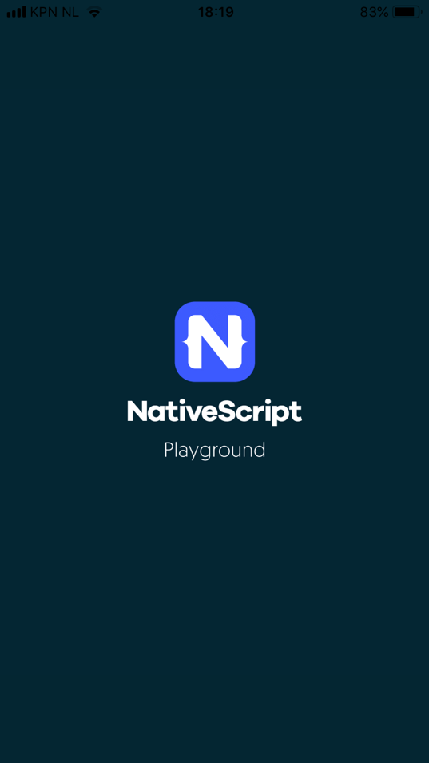
More Layout Containers …
AbsoluteLayout
WrapLayout
FlexboxLayout
https://docs.nativescript.org/angular/ui/layouts/layout-containers

Slide 17
NativeScript Playground
Write NativeScript code in the browser and preview on your device in seconds
https://play.nativescript.org

Slide 18
NativeScript Playground
NativeScript
Playground
NativeScript
Preview
https://play.nativescript.org

Slide 19
Theming

Slide 20
CSS
NativeScript supports a subset of the CSS Selector syntax
Type selector
Class selector
ID selector
Hierarchical selector (CSS Combinators)
Attribute selector
https://docs.nativescript.org/angular/ui/styling

Slide 21
CSS
Very much like CSS on web …
… except for Measurement units
NativeScript supports:
Device Independent Pixels (DIPs)
Pixels (postfix px)
Percentages

Slide 22
CSS
Styles can be set on 3 different levels:
Application-wide CSS
Component-specific CSS
Inline CSS

Slide 23
Platform specific styling
Platform specific css files app.ios.css app.android.css
Inline styling ios:style="..." android:style = "..."
Markup blocks <ios> ... </ios> <android> ... </android>

Slide 24
Themes
NativeScript comes with 13 predefined color schemes

Slide 25
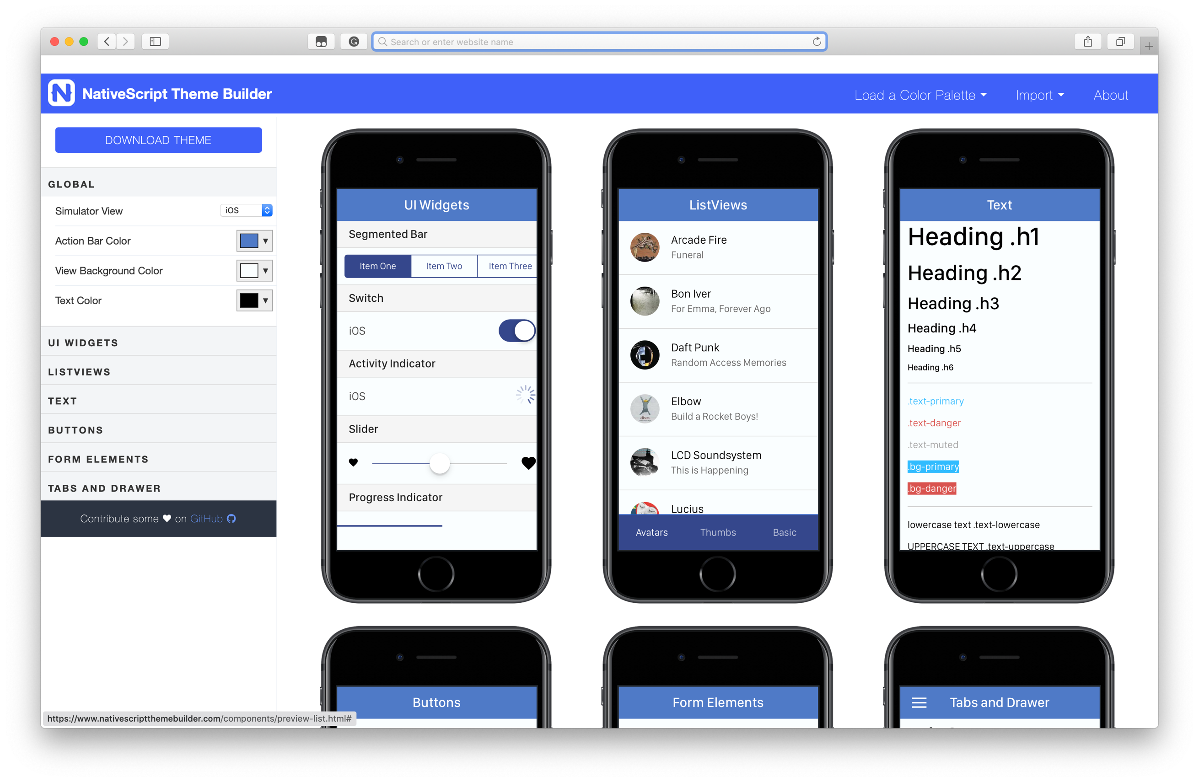
https://www.nativescriptthemebuilder.com

Slide 26
Native Code

Slide 27
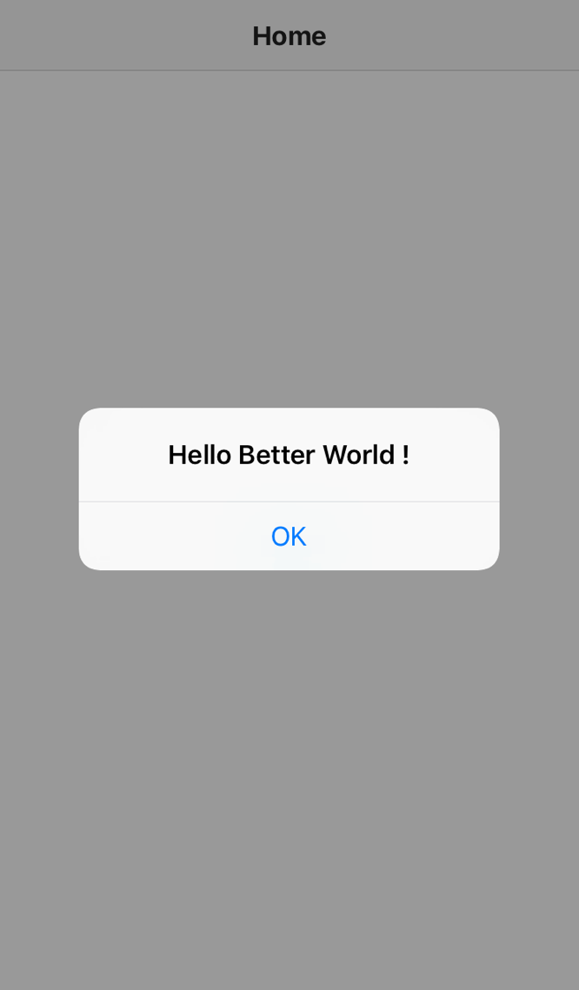
Native code
let alert = UIAlertView.new();
alert.message = 'Hello Better World !'; alert.addButtonWithTitle('OK’)
alert.show();

Slide 28
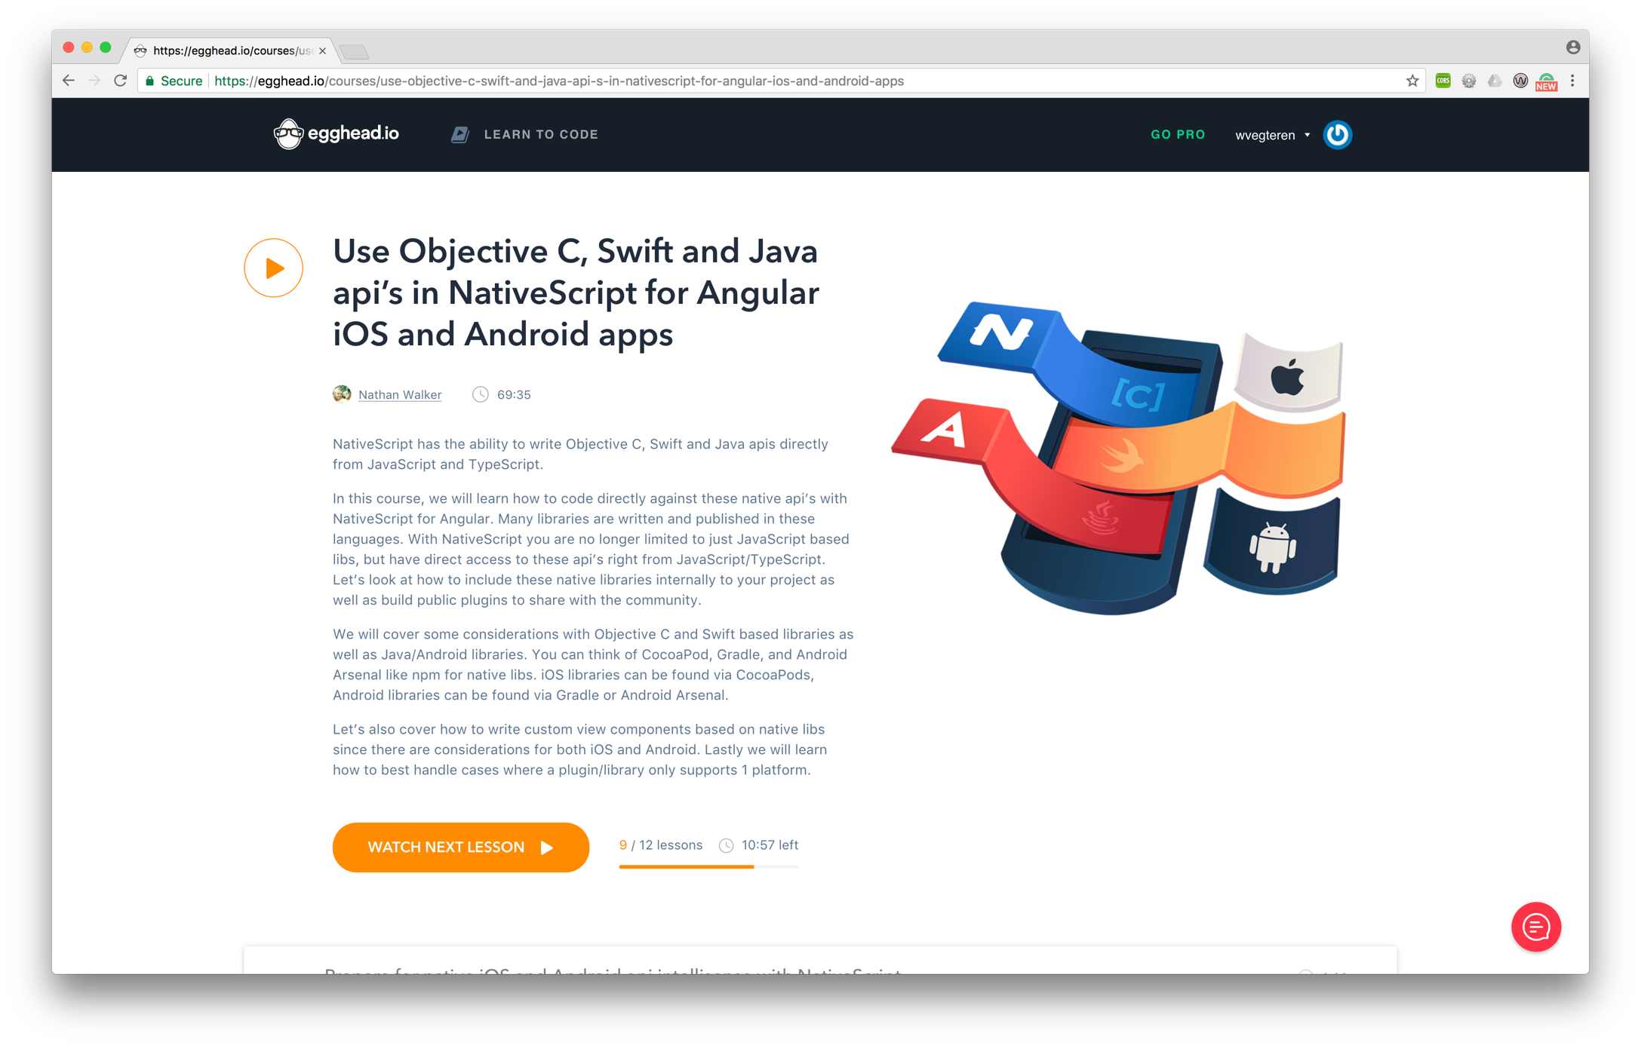
Native code

Slide 29



Native code
import {File } from "tns-core-modules/file-system";
let file = new File()
NSFileManager.defaultManager()
new java.io.File( path );

Slide 30
Plugins

Slide 31





Plugins
API

Slide 32
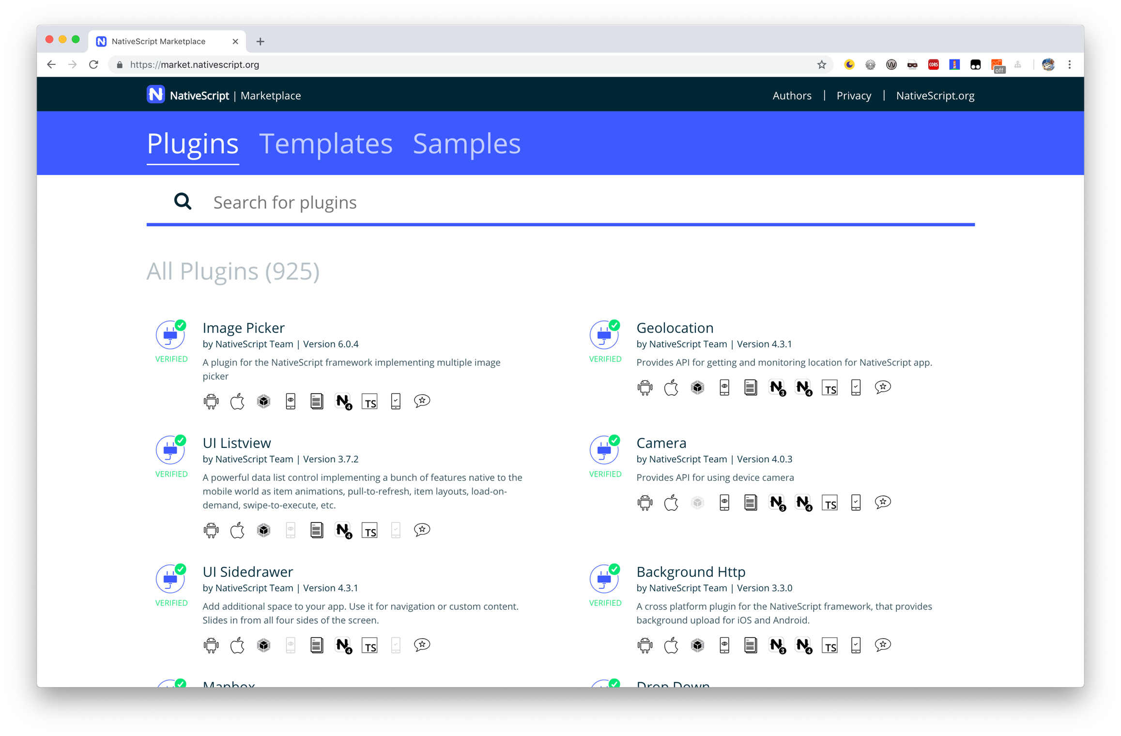
Plugins

Slide 33
NativeScript CLI

Slide 34
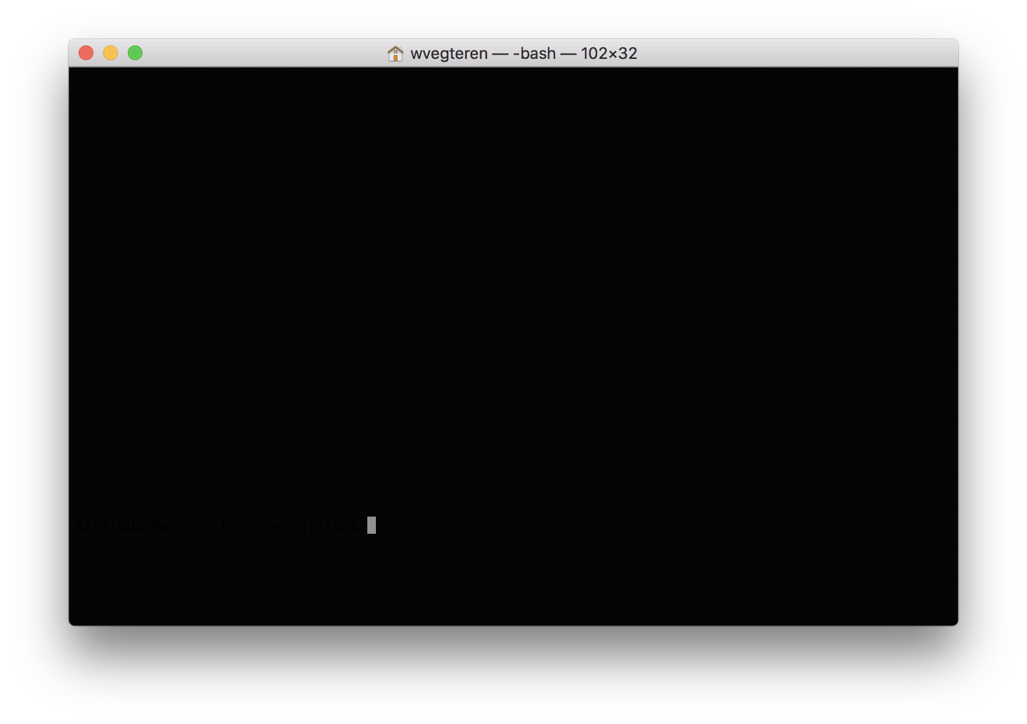
CLI - Installation
> npm install nativescript – g

Slide 35
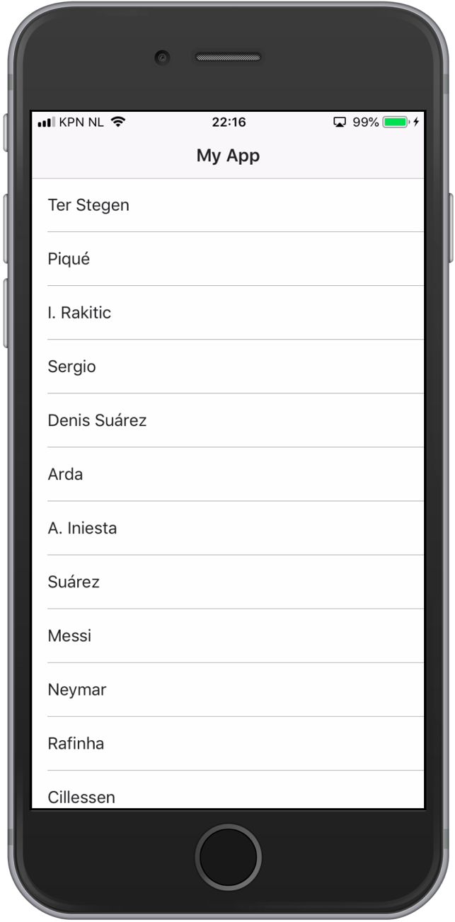
CLI - basic commands
> tns create MyEpicApp --ng
> cd MyEpicApp
> tns run ios

Slide 36
CLI - basic commands
> tns create MyEpicApp --ng
> cd MyEpicApp
> tns run ios
> tns run android

Slide 37
CLI - basic commands
Many more commands …
debug
test
run
build
https://docs.nativescript.org/tooling/docs-cli

Slide 38
Sidekick

Slide 39
Demo
https://docs.nativescript.org/sidekick

Slide 40
Code sharing

Slide 41
Now it’s your turn …
https://github.com/wvegteren/workshop-nativescript
WiFi access
TB-BYOD passphrase: !BYOD-P$K!$
Login:
Username workshop
Password: 649039

